Slide 1
Non-linear Decision Making for Role Based Autonomy
Ucheoma Ukah
Penn State University Applied Research
Laboratory
uiu5002@psu.edu
June 5, 2015

Slide 2
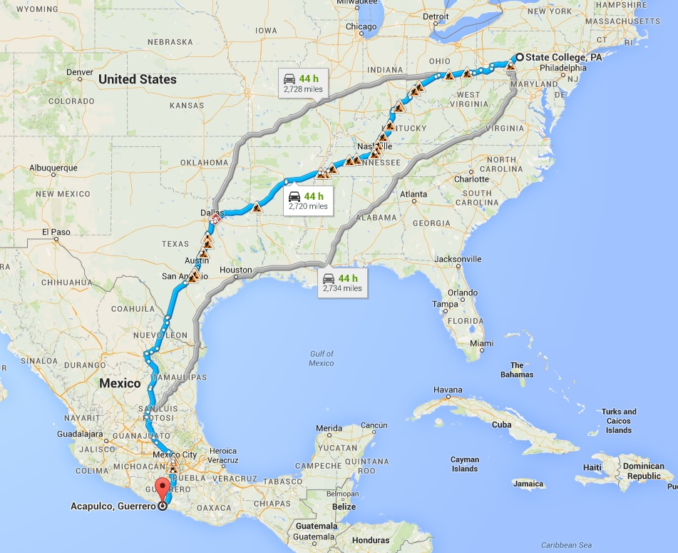
Introduction
Planning a trip to Acapulco, Mexico
Constraints
Must get there within a month
You can not travel outside of the western hemisphere
Tools
Expedia.com
Google Maps
List of known routes

Slide 3
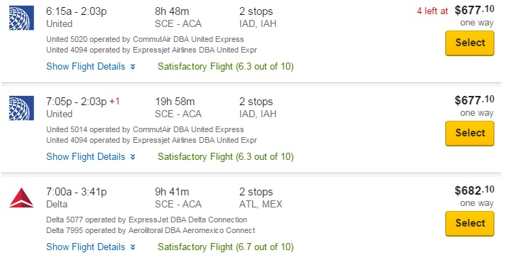
What people do…
Using the constraints given to us, our own constraints and our tool set, we construct a list of routes and filter until we find an efficient solution
Example: Although we have a month to get to Mexico we would rather get there in a few hours so we must fly by plane

Slide 4
Our Solution
Create a hybrid system to handle the decision making process on different levels
Soar
Workstation
Create a Navigator agent
Generates plans using traditional planning algorithms as decision aids
Reasons about feasibility of generated plans using Soar cognitive architecture
Interact with other agents using natural language

Slide 6
Concept
Navigator, plot course for waypoint tango-3-8. Arrive no later than 00:00UTC 27-June-2015. Maintain 7 nm distance from areas with water depths less than 100ft. Minimize crossing shipping lanes. Avoid active fishing areas.
Navigator Agent
Semantic Memory
Episodic Memory
Soar
CO
Captain, aye.
NAV
Soar decides which planning tools, cost functions, data, etc to use to find satisficed navigation solution in time available
Captain, navigation plan ready for your approval
Natural Language
C++
‘Agent Workstation’
NAV
Navigator, very well.
CO
Navigator, nav plan approved as noted.
CO
Captain, aye.
Charts &
Environment DBs
NavPlan
DB
NAV
Path Planning Tools
Officer of the deck, approved navigation plan ready.
NAV
Cost Functions
Navigator, very well.
OOD

Slide 7
Summary
Nuggets
Exciting project
Using Soar we hope to achieve autonomous navigation planning
Expecting basic Soar-based navigator to be working early July
Coal
Has not been implemented

